Slide 1
World Expo design
By: Zoila Cuevas
David Regis
Andrea Salceda

Slide 2
CLIENT
Our client is the USA Team World Expo.
It’s going to be located in South Korea

Slide 3
PROBLEM
There problem is that they want a design for The World Expo.
It’s a theme based designed that base on the ocean..

Slide 4
SOLUTION
Our solution was to make a structure that represents the ocean.
We had to create a design that has arcs on all sides that you see.

Slide 5
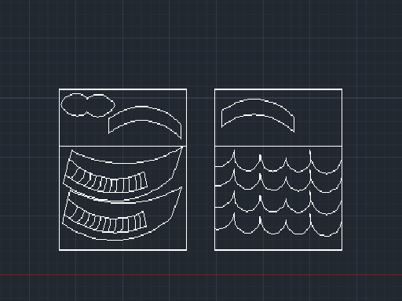
Design

Slide 6
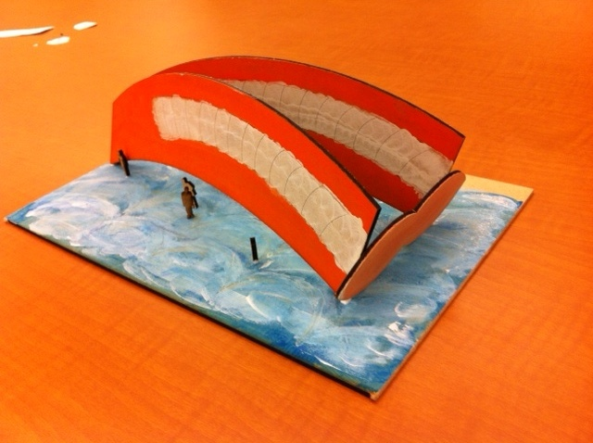
Description
The to arcs are the body of a gold fish.
The white is the scales.
The front arcs the are connected are the lips.
The floor is the waves of the ocean.
We have little people taking a look at our design.

Slide 7
PROTOTYPE

Slide 8
Summary
We made a structure that represented the ocean.
It’s an expo building like they wanted
Made out of arcs on all sides floor as well

