Slide 1
Skyscraping
By: Alexus Quiroz and Andrea Salceda

Slide 2
Client and problem
Our Client is Ms. Hanzel
Evolo 2012 Competition
Ms. Hanzel wants us to make a dry run for the Evolo competition
We need to find the volume, surface area and area of the shapes and the footprint
We also had to find the volume, surface are and area of the whole building
And we also had to estimate the cost of the building

Slide 3
Solution
Our solution was to create footprints that had vertical tapering and radial symmetry
And we also made a prototype
We used three geometric shapes
We found the volume, surface area, and area of all the shapes and floors
We also found the total area, surface area and volume of the skyscraper

Slide 4
Design 1

Slide 5
Total Area, Volume and Surface Area
Total area of footprint | 3178.794 m2
Total area of 19 floors | 60397.086 m2
Total Volume of footprint | 15893.97 m3
Total volume of 19 floors | 301985.43 m3
Total Surface area of footprint | 4351.098 m2
Total Surface area of 19 floors | 82670.862 m2

Slide 6
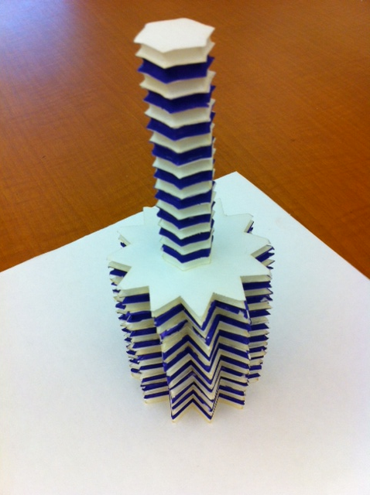
PROTOTYPE

