Slide 1
Our Awesome Math Problem
By: Isaiah Odom and Andrea Salceda

Slide 2
End –of–the Course-Exam
The end of the course exam has 40 questions.
You have to get at least 27 questions right to pass.

Slide 3
1st math problem: Write a variable expression: a number times 76
This is a multiplication problem because it says a number times
1st Step
First you write down the number

Slide 4
2nd step
Then you figure out what the other number is but since you don’t know what the other number is you put any variable

Slide 5
3rd step
And the answer you get is 76X

Slide 6
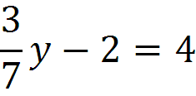
2nd math problem:
Solve:

Slide 7
1st step
You subtract 2 from both sides and you get

Slide 8
2nd step
Then you change into a reciprocal and you get

Slide 9
3rd step
Then you multiply on both sides

Slide 10
^{4th} step
Then the answer is
Then you reduce the fraction and get 14

