Slide 1
Linescape Project
By:
Tang Lee
Andrea Salceda
Alexa Duverseau

Slide 2
Client
Our client is Ms. Hanzel
She wants new ideas to redesign the school
The new designs had to include math

Slide 3
Problem
We needed to redesign three areas around the school
We needed to use lines and angles to do the three designs
The designs had to have things like sidewalks and water fountains.

Slide 4
Solution
We redesigned the three areas using lines and angles.
We includes waterfountains and sidewalks, and flowers.

Slide 5
THE MATH WE LEARNED
Supplementary Angles
Complementary Angles
Linear Pairs
Vertical Angles
Right Angles
Straight Angles
Acute Angles
Obtuse Angles

Slide 6
THE MATH WE LEARNED
Corresponding Angles
Alternate Exterior Angles
Alternate Interior Angles
Consecutive interior Angles

Slide 7
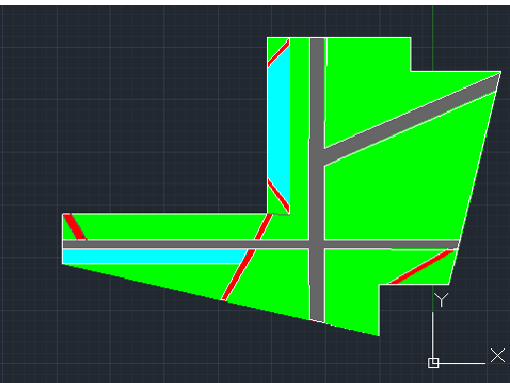
Area #1
Red: flowers
Grey: sidewalk
Blue: water fountains
Green: Grass

Slide 8
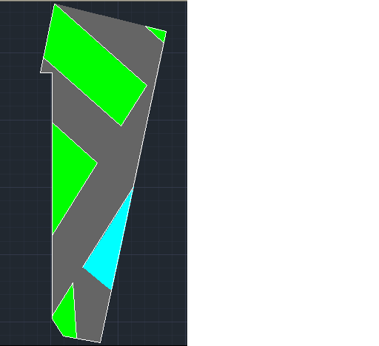
Area #2
Green: Grass
Grey: Sidewalk
Blue: Water fountain

Slide 9
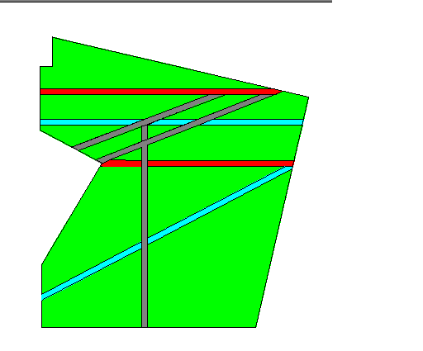
Area#3
Red: Benches
Grey: Side Walk
Blue: Trail of rocks
Green: Grass

Slide 10
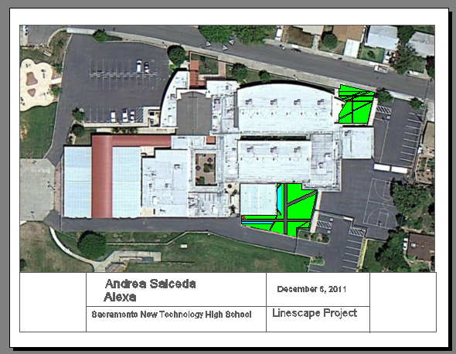
PROTOTYPE

