Slide 1
French door
By: Islam Nasyrov,
Andrea Salceda,
Christian Pearson-Lee

Slide 2
Problems
We must create new door designs for Milgard.
We each do a different part of the door.
We must use 7 types of triangles.
Draw pattern in AutoCAD.
Create a prototype.

Slide 3
Client
Our client is Milgard.
He wants new designs for his doors.

Slide 4
Solution
We created 3 different parts of the door using triangles.
We created designs using AutoCAD.
We use rotation, translation and reflection.

Slide 5
Rotation

Slide 6
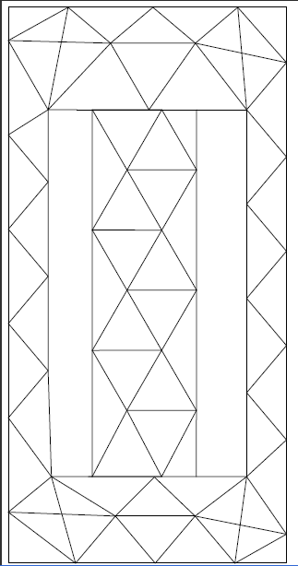
Translation

Slide 7
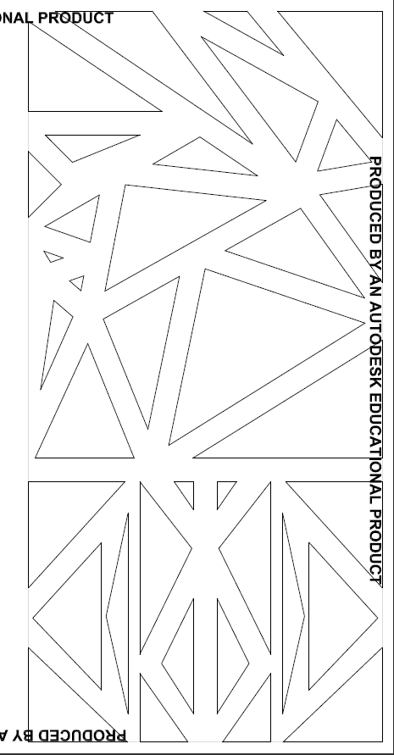
Reflection

Slide 8
French door

Slide 9
Summary
We create a new door design for Milgard.
Used 7 types of triangles.
We did our design in AutoCAD.
We must do prototype.

